Slide 1


Book Popularity Prediction
A data-driven approach to predicting book success using machine learning.
Team Members
Vinodh Kumar K M
-
PES2UG23CS696
Trigun Gurumurti Tamragouri -
PES2UG23CS656

Slide 2

The Core Challenge: Predicting Popularity
We addressed the challenge of predicting whether a book will achieve popularity based on its metadata and textual content.
Problem Statement
Predict if a book will be popular or not (Binary Classification).
Target Audience
Helps publishers, retailers, and libraries make data-driven decisions on acquisition and marketing.

Slide 3


Dataset and Target Variable
Our model was trained on a dataset containing both numerical metadata and rich textual features sourced from online book datasets.
Columns include: book_title, book_authors, book_desc, genres, book_pages, book_rating, book_rating_count, etc.
Source: Metadata and textual data from online book datasets.
Target Label: popular_book (0 = Not Popular, 1 = Popular)

Slide 4

Data Preprocessing Pipeline
Rigorous preprocessing was essential to transform raw data into a usable format for machine learning models.
Cleaning
Removed nulls and irrelevant characters from text fields.
Text Combination
Combined text columns (title + authors + description) for unified analysis.
Encoding & Scaling
Encoded categorical features and standardized numeric ones.

Slide 5

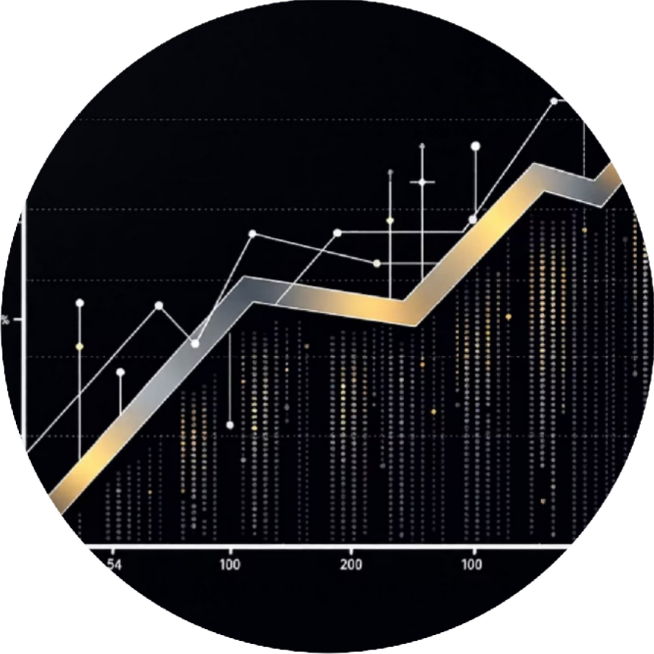

Feature Engineering: Text and Numerical Integration
We focused on creating powerful features by leveraging both the descriptive text and the quantitative metadata.
TF-IDF Vectorization
Used TF-IDF (Term Frequency-Inverse Document Frequency) for text embeddings, including unigrams and bigrams.
Numerical Scaling
Scaled numerical columns using StandardScaler to ensure equal contribution to the model.
Final Feature Matrix
Merged the scaled numeric data and the textual vectors to form the final feature set.

Slide 6

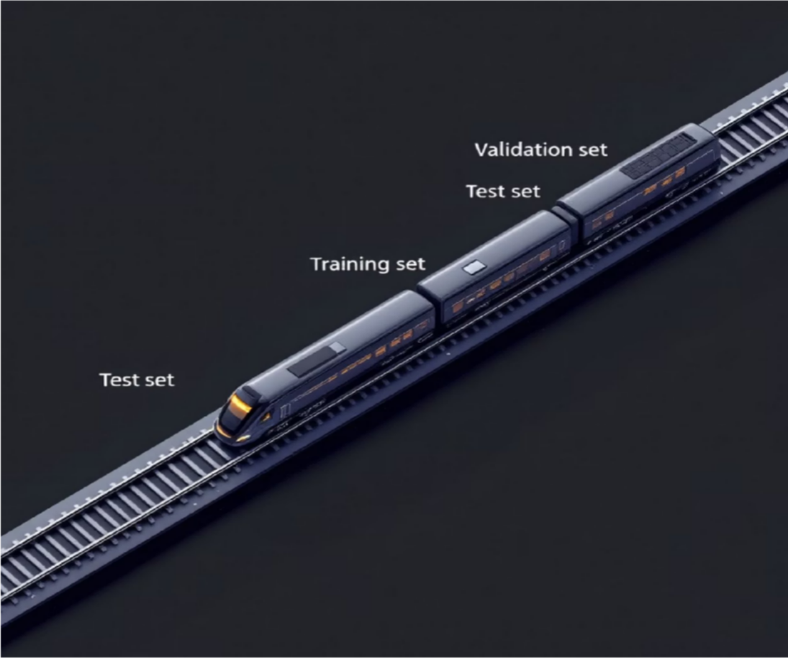
Machine Learning Models & Setup
We tested two robust classification models, ensuring balanced class weights to handle potential data imbalance.
Training Strategy
Data was split 80/20 for training and testing, utilizing stratification to maintain the original class distribution in both sets.
Logistic Regression
Used with class_weight='balanced' to mitigate class imbalance.
Random Forest Classifier
Employed 200 estimators and also used balanced class weights for robust performance.

Slide 7

Key Evaluation Metrics
Model performance was assessed using a comprehensive set of metrics crucial for binary classification tasks.
Accuracy
Overall correctness of the predictions.
Precision & Recall
Measuring the quality of positive predictions and the model's ability to find all positive samples.
F1-score
The harmonic mean of precision and recall, providing a single metric for balance.
ROC-AUC Curve
Evaluating the model's ability to distinguish between popular and non-popular books.

Slide 8
Model Performance Summary
Logistic Regression demonstrated superior performance, particularly in the F1-score and overall accuracy.
0.96
LR Accuracy
0.83
LR F1-Score
0.9761
ROC-AUC Score
Logistic Regression achieved the highest accuracy.
Strong balance between precision and recall for LR.
Excellent discriminative power across all models.
Logistic Regression | 0.96 | 0.83
Random Forest | 0.95 | 0.70

Slide 9
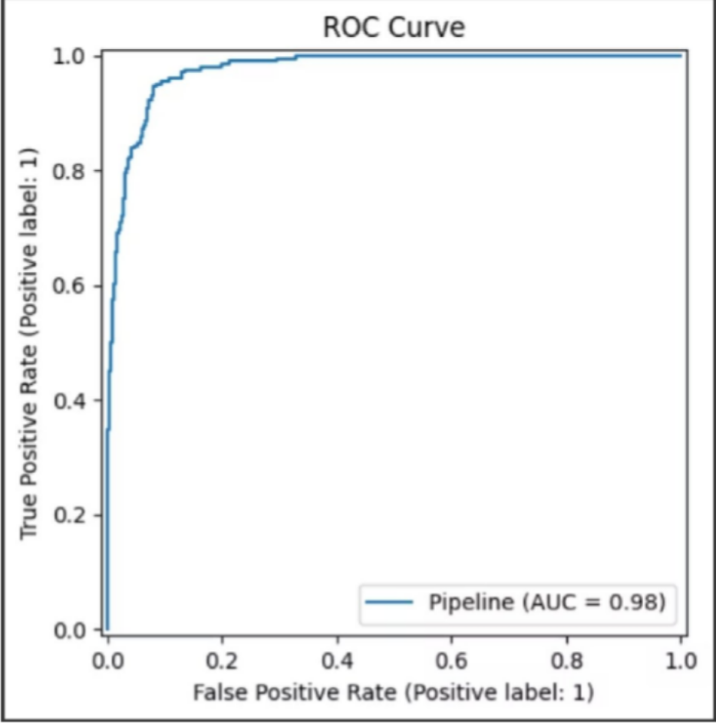
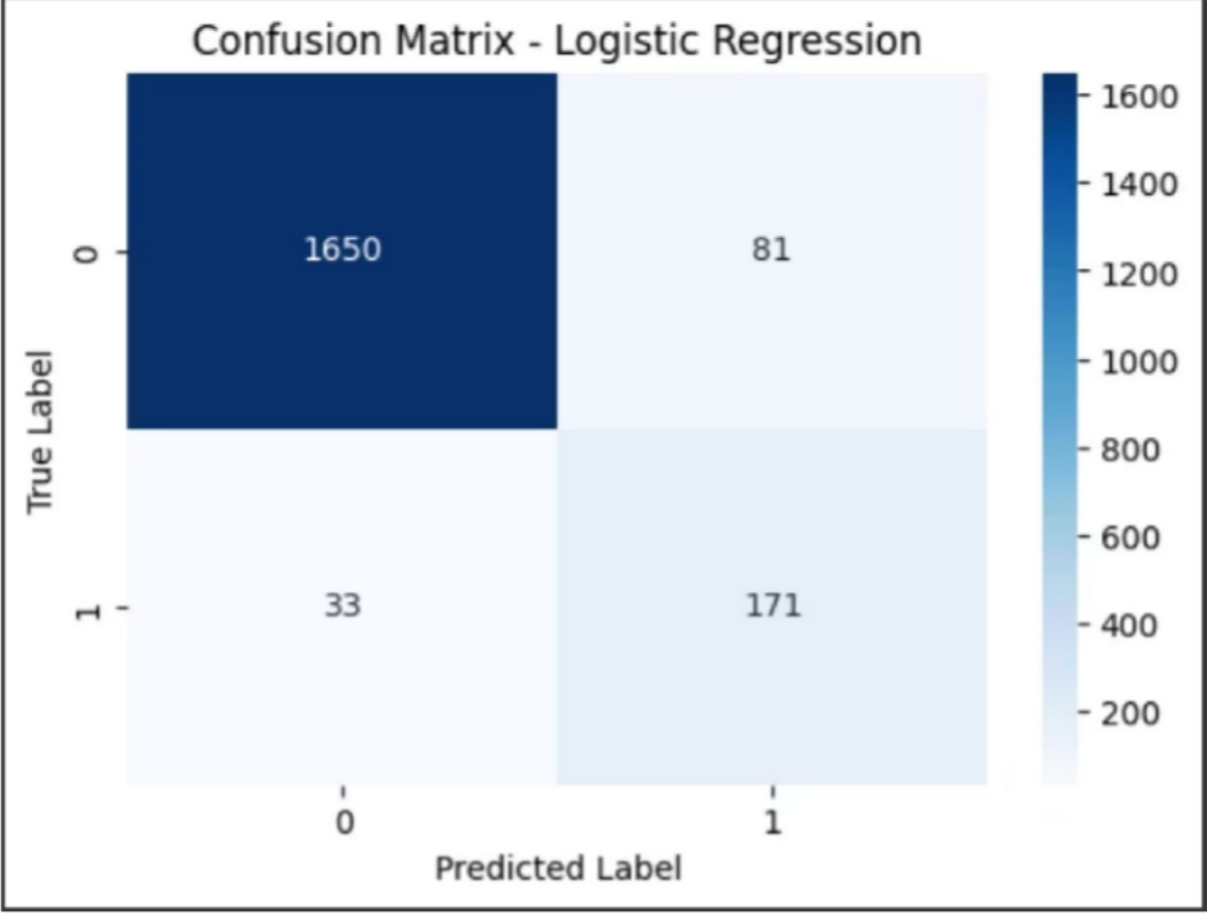
Visualizing Results
Visual tools like the ROC Curve and Confusion Matrix provide deeper insight into model behavior.
ROC Curve Plot
Confusion Matrix Heatmap
The high ROC-AUC score confirms the model's strong ability to separate the two classes.
Visually shows the true positives, true negatives, false positives, and false negatives.
Text-based features were identified as strong indicators of a book's potential popularity.

Slide 10




Conclusion & Future Trajectory
The project successfully established a high-performing prediction model, with clear paths for future enhancement.
Best Model
Logistic Regression was the top performer with 96% accuracy.
Advanced Text Analysis
Future work includes using deep learning models like BERT for more nuanced text analysis.
Temporal Data
Incorporate user reviews and temporal data for dynamic predictions.
Deployment
Deploy the model as a web application for practical use by publishers and readers.

